Slide 1

QR Code Attendance System
Prepared by:
Qutaibh Subeh: 202110464
Raad Salmouna: 202010749
Abdulrahman Banat: 202020146
Haithem El-bheery: 202010025

Slide 2




Problem Statement:
In educational institutions, the manual process of recording and managing student attendance can be time-consuming and error-prone. To address this challenge, there is a need for an efficient and automated attendance tracking system that leverages cloud-based Internet of Things (IoT) elements.

Slide 3

Materials/Tools: Google account. Smartphone with a QR code scanner app. Google Forms. Google Sheets. Internet connection. Web Page Contains The QR Code

Slide 4
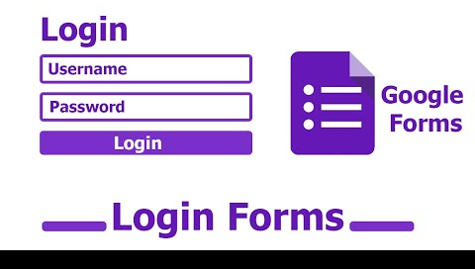

First, we need to create Google forms account:
Log in to your Google account and create a new Google Form for attendance, adding necessary fields like "Name" and "Student ID."

Slide 5
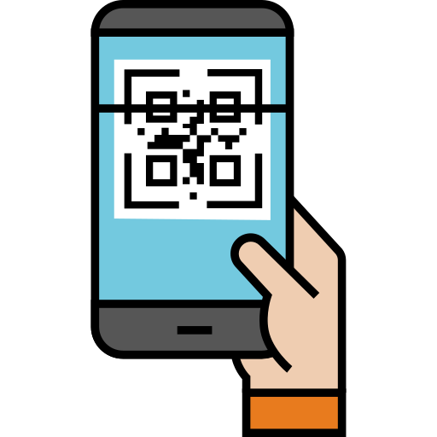
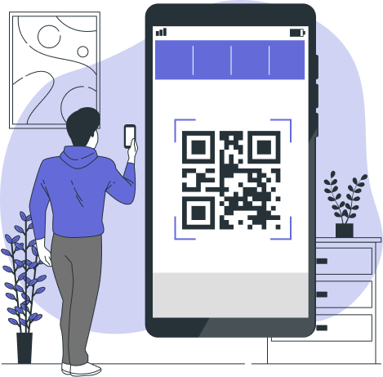
Generate QR Code for the Form: Once your form is created, click on the "Send" button, choose the "Link" option, and copy the form link to your clipboard.
Use an online QR code generator to generate a QR code for the copied form link.
Paste the QR Code on the Web Page
Print the generated QR code and display it in a visible location in the classroom.
Open the Web Page to Present the QR code to the students
Attendance Process:
When students enter the classroom, they use their smartphones to scan the QR code.
The QR code directs them to the Google Form, where they enter their name and student ID to mark their attendance.

Slide 6


Google Sheets for Data Storage:
Attendance data is automatically collected and stored in a Google Sheets spreadsheet associated with the Google Form.
Cloud Integration:
Leverage the cloud capabilities of Google Forms and Google Sheets for secure and scalable data storage.
Review Attendance Data:
Access the Google Sheets document to review and download the attendance data if needed.
Web Page for Secure:
Access is only permitted for the Teachers so they can edit it anytime.

Slide 7


Security Considerations: Ensure that your Google account is secured with two-factor authentication to protect attendance data. The attendance cannot be edited by the students, only the authorized people can access the Sheets/Forms. Documentation: Document the setup process, how the system works, and any additional features added during the cloud-based IoT integration.

Slide 8
Now we present you how to use the Attendance System

Slide 9
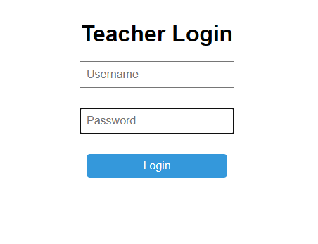
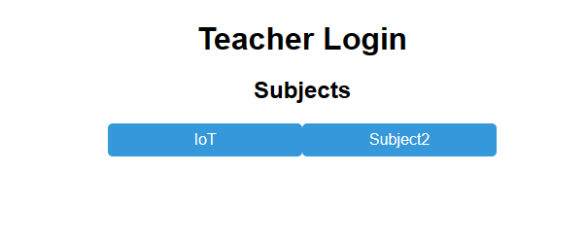
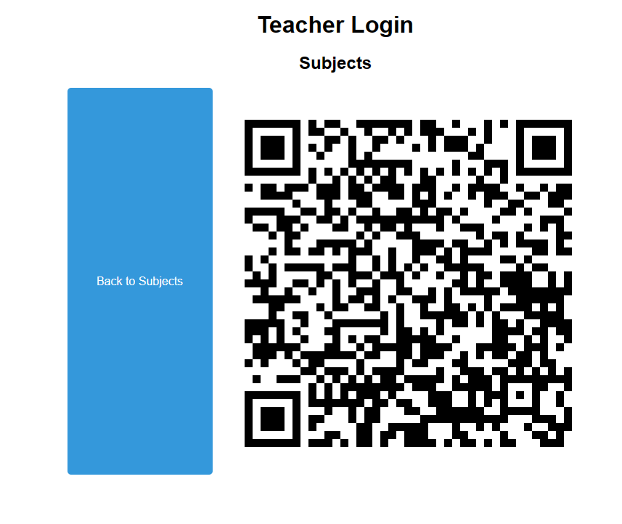
First, we have the Web Page that can be accessed by each teacher individually.
After the login, each teacher has his own Subjects that he can select from.
When the teacher chooses the Subject, the QR code for that specific Subject will appear to the students to scan.

Slide 10
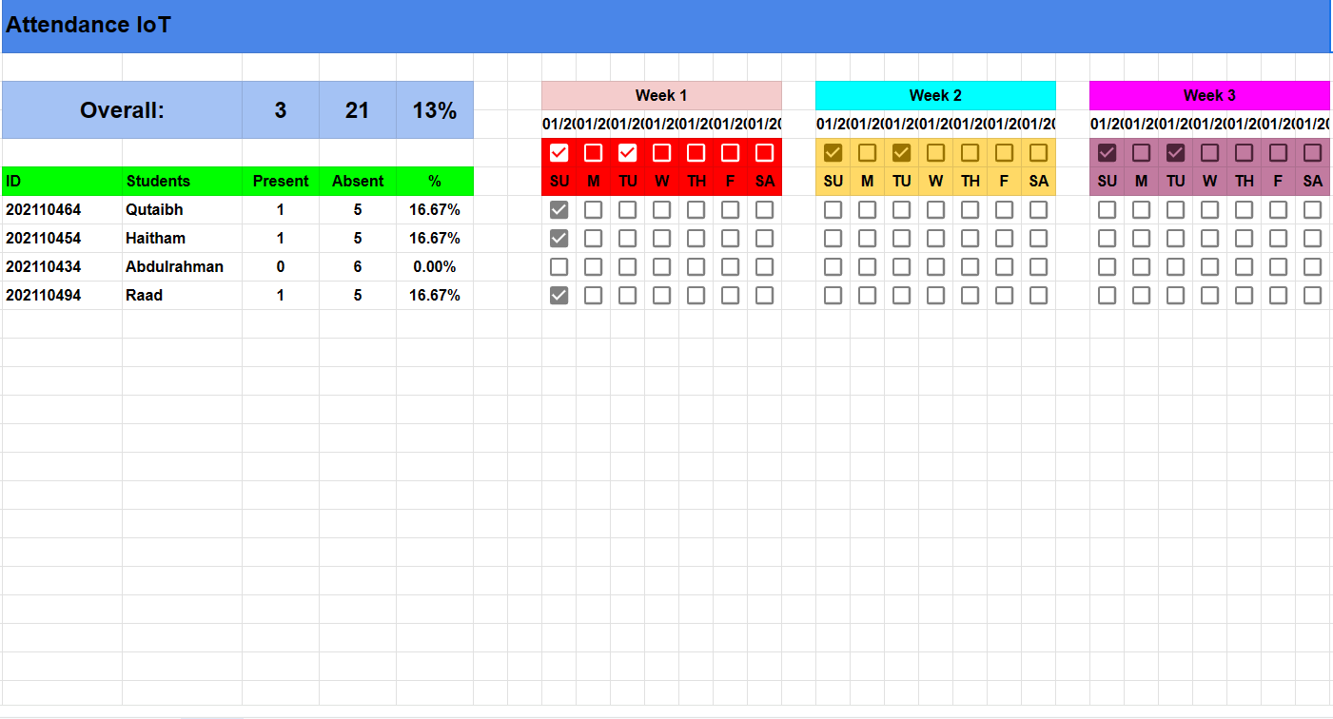
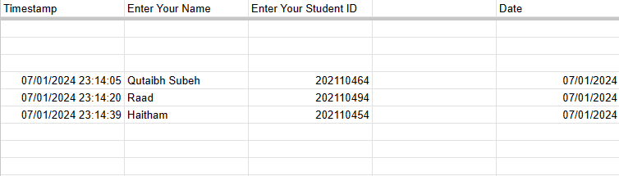
Here we can see that when the student scan the QR Code, the attendance appears on another linked Sheet with the same date and student ID.
On the sheet we can see the percentage of the present/absent students and the Overall course Attendance System.

Slide 11
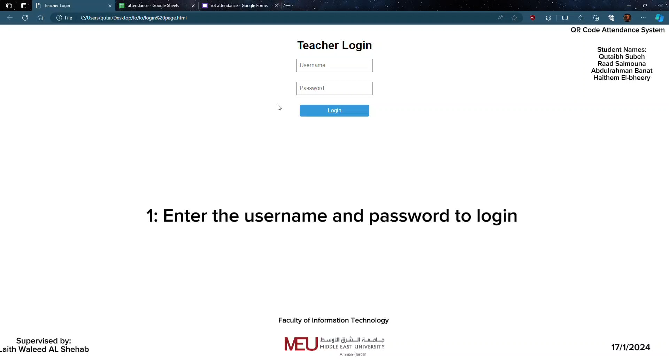
Here’s a demonstration Video for the System

Slide 12


Thank You
Supervised By Dr. Laith W. AL Shehab

